Slide 1
INSULIN BY PUMP
Diabetes Care Tasks at School
What Key Personnel Need To Know
Notes:
The American Diabetes Association’s (“ADA”) Diabetes Care Tasks at School: What Key Personnel Need to Know is a training curriculum consisting of PowerPoint modules, some with corresponding video segments, pre-/post-tests and other helpful resources.
This curriculum is based on and should be used in conjunction with the ADA’s Safe at School Guide “Helping the Student with Diabetes Succeed: A Guide for School Personnel”. Training participants should read the ADA Safe at School Guide in conjunction with this training to gain a better understanding of the requirements for appropriate school diabetes care. The ADA’s Safe at School Guide can be found www.diabetes.org/sastraining.
Some key points about the overall training:
Overall objective: The overall goal is to optimize safety, health, learning, and access for students with diabetes by providing diabetes education and training to school personnel to perform routine and emergency diabetes care tasks for students, under the supervision of a school nurse or another qualified health care professional. Completion of this training will help prepare school personnel to perform diabetes care tasks, ensuring that health needs are addressed in times and locations when a nurse is not available to provide needed care.
Rationale: The school nurse, when available, is the most appropriate person in the school setting to provide care for a student with diabetes. However, many schools do not have full-time nurses. Even for schools that do, the nurse may not always be available at all times during the school day, during school-sponsored extra-curricular activities or field trips to assist with routine care and emergency care. Trained school personnel must be available to perform and assist the student with diabetes care tasks.
PLEASE STATE: This presentation is not intended to provide legal or health care advice. Please consult with a legal or health care professional regarding your specific questions or needs.

Slide 2
Optimal Student Health and Learning
GOAL:
Accurate and timely insulin dosing is a vital piece of the Diabetes Medical Management Plan (DMMP).
Notes:
Each training component was created specifically for school nurses and other qualified health care professionals to train school personnel.
These components are:
• Diabetes Basics
• Diabetes Medical Management Plan
• Hypoglycemia
• Hyperglycemia
• Blood Glucose Monitoring
• Continuous Glucose Monitoring
• Glucagon Administration
• Insulin Basics
• Insulin by Syringe and Vial
• Insulin by Pen
• Insulin by Pump
• Ketones
• Nutrition and Physical Activity
• After-School Programs, Sports and Camps
• Before- and After- School Care
• Childcare
• Psychosocial Aspects
• Legal Considerations
• Type 2 Diabetes
This unit is Insulin by Pump.

Slide 3
Learning Objectives
PARTICIPANTS WILL BE
ABLE TO UNDERSTAND:
Basic types and features of insulin pumps
What pumps do
Essential information and skills for key school personnel who might perform or assist in entering data or delivering insulin with a pump
Notes:
Participants will be able to understand:
Basic types and features of insulin pumps
What pumps do
What is the essential information and skills for key school personnel who might perform or assist in entering data or delivering insulin with a pump
In addition to understanding insulin dosing and delivery using an insulin pump, it is important for school staff who administer insulin to a student or assist a student with insulin administration understand the fundamentals of insulin action, dosing and delivery. These general concepts are covered in the unit entitled, “Insulin Basics.”

Slide 4
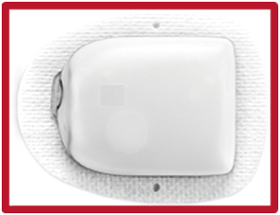
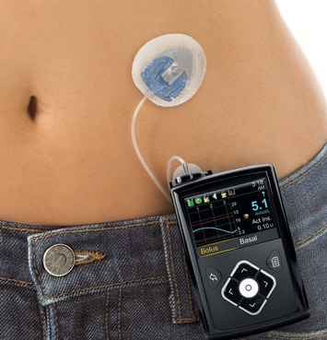
What is an Insulin Pump?
Device about the size of a pager
Reservoir filled with insulin
Insulin is delivered by tubing or from a patch
Worn 24 hours per day
Delivers only rapid-acting insulin
Notes:
An insulin pump is an external, battery-powered device that continuously delivers insulin in small doses to the body.
Most pumps, like the one on the left in the blue bordered frame, look very much like a pager or phone and can be attached to a belt or waistband, carried in a pocket, or held with a strap around the arm or thigh. The pump contains a cartridge or reservoir of insulin.
These pumps deliver insulin through a tube, as shown in the large picture on the screen. The pump connects to narrow, flexible plastic tubing that ends with a short plastic catheter inserted just under the skin in the abdomen, buttocks, or thigh. Users set the pump to give a steady trickle or "basal" amount of insulin continuously throughout the day. Pumps release "bolus" doses of insulin (several units at a time) at meals and at times when blood glucose is too high based on the user’s programming.
Some pumps , like the one in the lower right in the red bordered frame, are attached directly to the body. This newer kind of insulin infusion pump is often referred to as a patch pump or “pod”. This type differs in that it adheres directly to the skin, without using additional tubing. It is a disposable unit that is controlled by a separate PDM device. In the pod-type pumps, insulin is still continuously delivery through a short plastic catheter on the underside of the pod and inserted just under the skin in the abdomen, buttocks, or thigh.

Slide 5
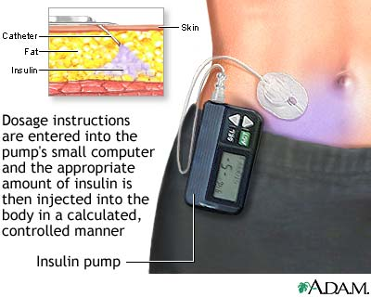
Dosing with an Insulin Pump
Notes:
An insulin pump delivers one type of insulin – no mixing types.
Newer models have a number of calculation and reminder wizards, for example to assist with calculating insulin bolus dosage based on carbohydrate intake and blood glucose level or to remind users about active insulin while dosing.

Slide 6
Insulin Pump Therapy
Based on what the body does naturally
  Small amounts of insulin all the time (basal insulin)
Extra doses to cover each meal or snack as well as correct an elevated glucose (bolus insulin)
Precision, micro-drip insulin delivery
Flexibility
Ease of correction for high blood glucose (blood sugar) levels; keeping track of insulin on board (IOB)
Notes:
Pump therapy is based on what the pancreas does naturally - delivers small amounts of insulin all the time (basal insulin) - and then at meals or snacks, extra insulin is delivered to cover that amount of food (bolus insulin).
Pumps generally dose rapid acting insulin (occasionally a student may use short-acting or regular insulin).
Students who are on injections use both long and rapid or short acting insulin. Generally their long-acting insulin will be taken either once or twice daily.
The pump delivers insulin in micro-drops that are continuous and accurate. The level of activity directly affects how quickly insulin goes into the bloodstream. When sitting at a desk, it will go into a student’s system more slowly. If the student goes for a walk or a run, it will go into her system much more quickly.
The primary advantage of pump technology is in how it facilitates basal insulin delivery:
It allows for finer adjustment and greater accuracy in fractional doses, for example 2.2 units.
Additionally pump technology is a more convenient way to deliver the multiple bolus doses throughout the day, without having to inject each time.
Those pumps that monitor “on board” or active insulin, also help to prevent overlapping doses that might lead to hypoglycemia.

Slide 7
What Pumps Do
“BELLS AND WHISTLES”
Most pumps will calculate bolus dosages
Some pumps communicate with blood glucose meters and/
or continuous glucose monitoring systems.
Tracking active insulin (IOB)
Temporary basal rates
LIMITATIONS:
Pumps rely on accurate input from humans to calculate dosing. The user can override pump-calculated doses.
Notes:
With the ever changing capacity of portable technologies, many pumps can do much more than simply deliver insulin. For example:
Modern 'smart' pumps have a 'bolus calculator' which calculates how much 'bolus' insulin you need taking into account your expected carbohydrate intake and current blood glucose.
Some pumps communicate with blood glucose meters or continuous glucose monitors to help with analyzing management decisions.
Some track and signal active insulin
Some allow for temporary basal rates (for example, lowered during physical education.)
Some are capable of data sharing with the caregiver remotely; however, communication is dependent on their connected smart device. Real-time data sharing with the caregiver(s) and/or school staff should be specified in the student’s 504 Plan.
However, all pumps must still rely on input from human beings to determine dosing.
The user still has to enter information about carbohydrate intake and glucose levels, in order for the pump to determine and deliver the correct dose, based on settings that are pre-programmed by the student, parent/guardian, or health care team. Not all pumps calculate dosing; in those that do calculate, the user is able to override the pump-calculated dose manually.
An insulin pump requires programming, close monitoring, and frequent glucose checks (blood glucose or CGM, per DMMP). Pump settings are determined by the student, parent/guardian, and health care provider.

Slide 8
Artificial Pancreas Systems
Hybrid closed loop systems self-adjust insulin delivery based on sensor data.
Includes a pump and sensor to partially automate insulin delivery
Helps the student stay more in a target glucose range
Can be used in hybrid closed loop or as a basic pump (without automated delivery). The student will still need to bolus for food/make corrections.
  Tandem, t:slim X2 automated delivery Control IQ
  Medtronic 670G or 770G automated delivery = Auto Mode
  Omnipod 5 automated delivery automated mode
Notes:
More advanced “artificial pancreas systems” self-adjust insulin delivery based on CGM data. These systems may be used to help the student stay in target glucose range. It’s not expected that school personnel would understand all details of each system; however, it’s important to understand that the system is dependent on sensor information to continue in this hybrid closed loop mode (with automatic self-adjustments). As always, management details should be outlined in the student’s DMMP and/or 504 Plan since many of the system features are dependent of what type of system and how the student is recommended to use the sensor.
Hybrid closed loop systems available today include Tandem’s t:slim X2 with Control IQ and Medtronic’s 670G and 770G systems.

Slide 9
Artificial Pancreas Systems
Blood glucose checking with a meter may or may not be required, follow the DMMP for each student
Important to address alerts
Students must still bolus before meals/snacks
If insulin is given by injection for ketones, hybrid closed loop should be disabled
Students who cannot self-manage independently will require assistance
Notes:
Several systems now exist, and technology continues to evolve. Recommendations for use will vary depending on the system.
The Tandem, t:slim X2 with Control IQ System:
Allows automatic micro insulin adjustments to help keep students in goal blood glucose range
CGM values may be used to make treatment decisions if the conditions discussed in the CGM ppt have been met and the student’s DMMP states the student can use the device to make treatment decisions
Important to address any alerts, including CGM unavailable, to continue control IQ delivery
The Medtronic 770G and 670G Systems :
Allows automatic micro insulin adjustments to help keep students in goal blood glucose range
Blood glucose testing still required by student for treatment decisions, per DMMP
Important to address alerts, including “enter BG” or calibration requests immediately to continue auto mode delivery
Each hybrid closed loop should be disabled if insulin is provided by injection for ketones – this is to prevent insulin stacking and related risk for hypoglycemia.
Students who cannot self-manage independently will require help responding appropriately to alerts or CGM alarms.

Slide 10
What Key Personnel Need to Know About an Insulin Pump
How to deliver routine boluses for carbohydrates (carbs) and high blood glucose
Signs/symptoms that pump site may need to be changed
When an injection by pen or syringe is indicated
How to disconnect or “suspend” the pump
  In the event the student becomes unconscious or has a seizure
  If instructed by the parent/guardian or diabetes care provider, e.g., during activity
Notes:
Depending upon the developmental level of the child, the school nurse or trained school personnel may need to perform or assist students with pump functions. Each pump requires specific training.
Some students, especially younger ones, will need assistance with calculating or entering in the correct carbohydrate or blood glucose values, both to cover for meals or snacks and to correct for high blood glucose.
The school nurse or trained school personnel should be aware of the signs and symptoms that a infusion site may need to be changed. Ordinarily, infusion sets are changed every 3 days.
Additionally, the DMMP specifies when an injection by syringe or pen is needed, and when to assist the student as needed in administering insulin by syringe or pen if blood glucose is far above target range, is not responding to a correction bolus, or if ketones are present.
Rarely, a pump may need to be suspended or disconnected if a student becomes unconscious or experiences a seizure. Staff should be trained to perform or assist the student in performing suspensions or disconnections, as per instructions from the parent/guardian or health care provider as specified in the DMMP. For example, some students may disconnect during physical education class or during extracurricular athletics.

Slide 11
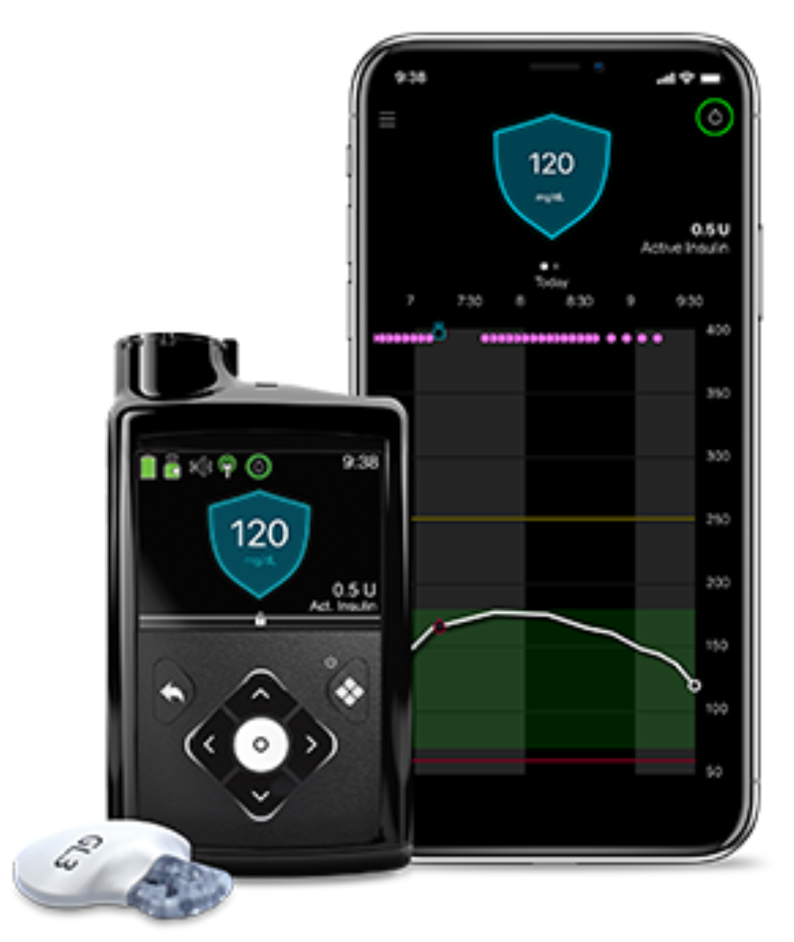
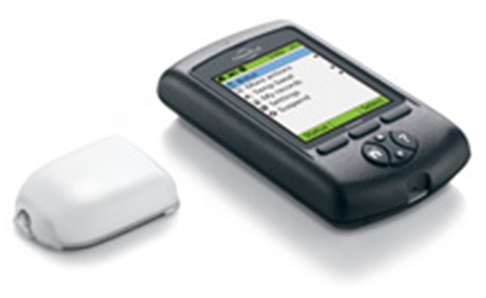
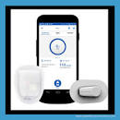
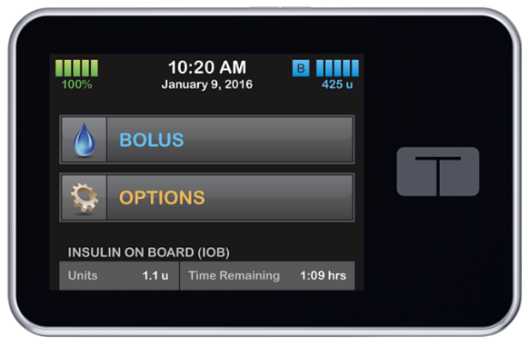
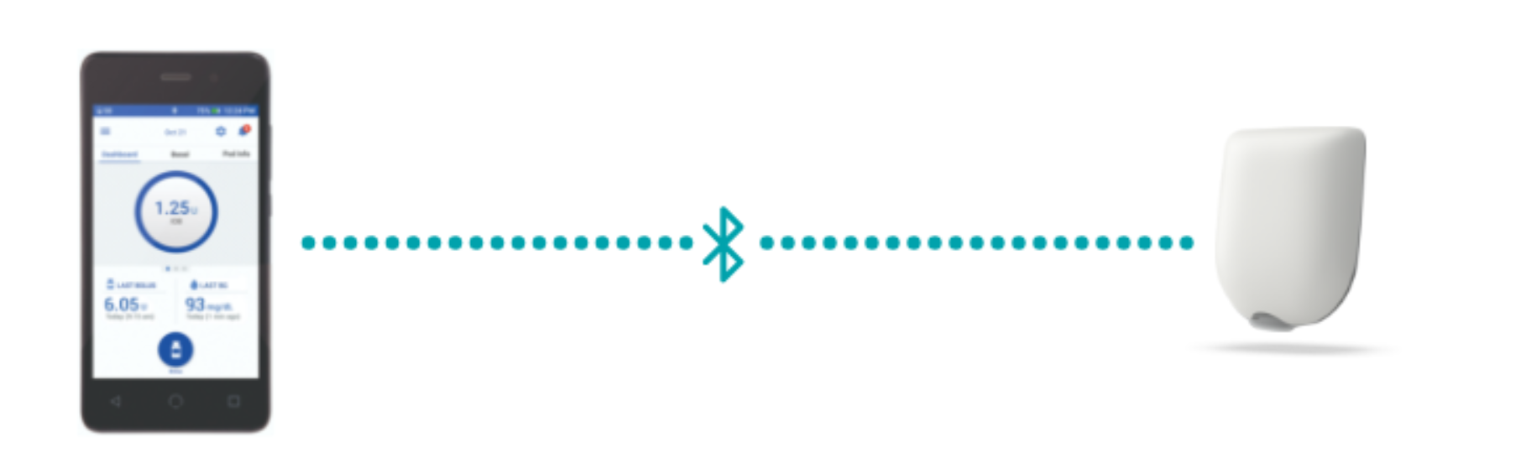
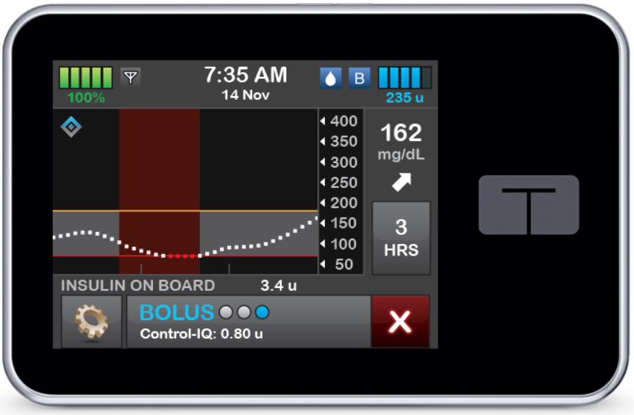
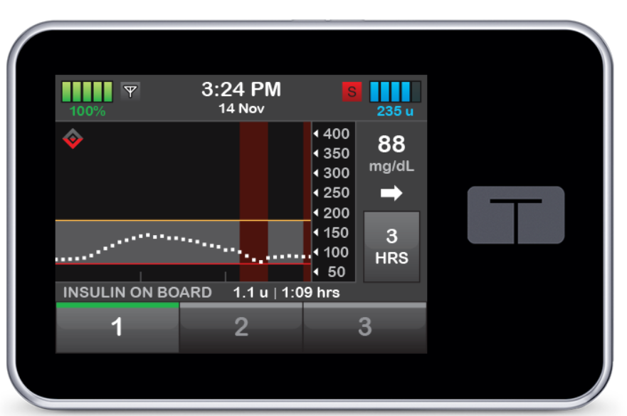
Sampling of Pumps
Notes:
There are a number of different pumps are on the market.
Pump manufacturers are often the best resource for training resources and education and commonly have quick references available.
Insulin Pump Manufacturers
Insulet Omnipod or Omnipod DASH -- http://www.myomnipod.com/
Minimed 730G, 770G -- http://www.medtronicdiabetes.com/
Tandem, t:slim X2 with Basal IQ or Control IQ -- https:www.tandemdiabetes.com

Slide 12
Method of Delivery
In cases of pump or site malfunction, always notify the parent/guardian
Immediate site change is recommended if a pump site error occurs. For delayed or pump malfunctions, one common response is to provide correctional insulin with injection to reduce risk for hyperglycemia (high blood glucose) and diabetic ketoacidosis (DKA)
INSULIN INJECTION
INSULIN PUMP
Prescribed insulin therapy
Prescribed as back-up plan if insulin pump malfunctions
Prescribed for only certain seasons – determined by student, parent/guardian, and provider
Prescribed and intended year-round use unless pump malfunctions
Prescribed and used for only certain reasons – determined by student, parent/guardian, and health care provider
Notes:
Method of insulin delivery is determined by the student, parent/guardian and provider and therapy may change. It’s important to be prepared that students on insulin pumps may still require injections during cases of pump or pump site malfunction. In cases of pump or site malfunction, call parent/guardian, per DMMP.

Slide 13
Pump Supplies at School
Infusion set and reservoir (or pod)
Insulin
Skin prep items
Alcohol wipes
Syringe (in case of pump malfunction)
Pump batteries (or charger, if used)
Insulin pump site Inserter (if used)
Manufacturer's manual, alarm card
In cases where the pump is disconnected (for example in PE), the insulin pump should be placed in a secure place as designated in the student’s written DMMP. In cases of pump or site malfunction, always notify the parent/guardian, endocrinologist, and back-up plan, per DMMP.
Notes:
The following supplies should be provided by the parent/guardian and kept in a designated place at school:
Infusion set
Reservoir
Insulin
Skin prep items
Alcohol wipes to clean top of insulin vial
Syringe - All students should have a syringe at school in in case of pump malfunction.
Pump batteries
Inserter (if used)
Manufacturer's manual, alarm card
In cases where the pump is disconnected (for example in PE) it should be placed in a secure place as designated in the student’s written plans.
In cases of site malfunction, the site should be immediately replaced and/or insulin should be given by syringe or pen as per the student’s DMMP. Call parent/guardian as per DMMP to confirm back-up plan. Infusion set placement requires training and is routinely done at home but students who have been identified as capable of managing independently may carry pump supplies for immediate site change as necessary.

Slide 14
Module 9 Pre- and Post-Tests:
INSULIN BY PUMP
This tool may be freely duplicated and distributed for training purposes

Slide 15
Pumps deliver insulin through:
  A tube inserted under skin
  A pod attached to body
  a and b
Most pumps can calculate insulin dosages based on carbohydrate intake and blood glucose levels entered into the device.
  True
  False
Advantage(s) of using an insulin pump that have been reported include:
  Allows for finer adjustment of insulin dosages
  Convenience without multiple daily injections
  Monitors “on board” or “active” insulin
  Calculates insulin dosage
  All the above
A back-up plan for giving insulin should be in place for any problems with the pump.
  True
  False

Slide 16
Disclaimer
This presentation is not intended to provide legal or health care advice. Please consult with a legal or health care professional regarding your specific questions or needs.

Slide 17
Where to Get More Information
AMERICAN DIABETES ASSOCIATION
1-800-DIABETES (342-2383)
DIABETES.ORG/SAFEATSCHOOL

