Slide 1
INSULIN BASICS
Diabetes Care Tasks at School
What Key Personnel Need To Know
Notes:
The American Diabetes Association’s (“ADA”) Diabetes Care Tasks at School: What Key Personnel Need to Know is a training curriculum consisting of PowerPoint modules, some with corresponding video segments, pre-/post-tests and other helpful resources.
This curriculum is based on and should be used in conjunction with the ADA’s Safe at School Guide “Helping the Student with Diabetes Succeed: A Guide for School Personnel”. Training participants should read the ADA Safe at School Guide in conjunction with this training to gain a better understanding of the requirements for appropriate school diabetes care. The ADA’s Safe at School Guide can be found www.diabetes.org/sastraining.
Some key points about the overall training:
Overall objective: The overall goal is to optimize safety, health, learning, and access for students with diabetes by providing diabetes education and training to school personnel to perform routine and emergency diabetes care tasks for students, under the supervision of a school nurse or another qualified health care professional. Completion of this training will help prepare school personnel to perform diabetes care tasks, ensuring that health needs are addressed in times and locations when a nurse is not available to provide needed care.
Rationale: The school nurse, when available, is the most appropriate person in the school setting to provide care for a student with diabetes. However, many schools do not have full-time nurses. Even for schools that do, the nurse may not always be available at all times during the school day, during school-sponsored extra-curricular activities or field trips to assist with routine care and emergency care. Trained school personnel must be available to perform and assist the student with diabetes care tasks.
PLEASE STATE: This presentation is not intended to provide legal or health care advice. Please consult with a legal or health care professional regarding your specific questions or needs.

Slide 2
Optimal Student Health and Learning
GOAL:
Accurate and timely insulin dosing is a vital piece of the Diabetes Medical Management Plan (DMMP).
Notes:
Each training component was created specifically for school nurses and other qualified health care professionals to train school personnel.
These components are:
• Diabetes Basics
• Diabetes Medical Management Plan
• Hypoglycemia
• Hyperglycemia
• Blood Glucose Monitoring
• Continuous Glucose Monitoring
• Glucagon Administration
• Insulin Basics
• Insulin by Syringe and Vial
• Insulin by Pen
• Insulin by Pump
• Ketones
• Nutrition and Physical Activity
• After-School Programs, Sports and Camps
• Before- and After- School Care
• Childcare
• Psychosocial Aspects
• Legal Considerations
• Type 2 Diabetes
This unit is Insulin Basics.

Slide 3
Learning Objectives
PARTICIPANTS WILL BE
ABLE TO UNDERSTAND:
What insulin does
Types of insulin
Insulin delivery methods
Storing insulin
Factors that influence insulin dosing
Notes:
The objectives are for participants to be able to understand:
What insulin does
Types of insulin
Insulin delivery methods
Storing insulin
Factors that influence insulin dosing
School personnel responsible for performing diabetes care tasks or assisting with the student’s diabetes care tasks should know about and be trained in using and operating each student’s insulin delivery system. In the event a school nurse is not available to administer insulin, the nurse or another qualified health care professional should teach, monitor, and supervise trained diabetes personnel to administer insulin.
School staff who will perform or assist students with insulin administration should understand how insulin works.

Slide 4
Vocabulary
TARGET RANGE:
A range of numbers that represents an individual’s ideal blood glucose levels, determined by health care team with the individual student with diabetes and parent/guardian
BASAL INSULIN:
Sometimes called “background” insulin, the insulin working steadily throughout the day
CARBOHYDRATE (CARB) OR MEAL/SNACK BOLUS:
Insulin doses for food
BOLUS INSULIN:
A single dose of insulin, given for food and/or correction
CORRECTION BOLUS:
Insulin dosed when blood glucose level is too high and needs to be corrected (made lower)
Notes:
Target Range: A range of numbers that represents an individual’s ideal blood glucose level; determined by health care team with the individual child with diabetes and parent/guardian.
Everyone’s blood has some glucose in it. In people who don’t have diabetes, the normal fasting range is about 70 to 100 Universal.
The American Diabetes Association sets guidelines for normal and abnormal blood glucose levels. However, each person’s target range is determined individually by his/her health care team. Young children with diabetes may have slightly higher target ranges than adults with diabetes. And those starting out on insulin pump therapy or are newly diagnosed with diabetes may initially have higher target ranges to help avoid hypoglycemia.
Basal Insulin: Sometimes called "background" insulin, the insulin working steadily throughout the day.
Basal insulin may be provided by injection with either long acting or intermediate acting insulin or by continuous infusion of short or rapid acting insulin with an insulin pump.
In diabetes treatment the term basal refers to that low amount of insulin that is always needed to cover the basal metabolic functions of daily living (i.e. breathing, heart rate, and other metabolic processes of the body). That is, the insulin needed to maintain good blood glucose control without taking in any food/sweetened drink.
Bolus Insulin: a single dose of insulin, given for one of two reasons:
Carb or Meal/Snack Dose: Insulin dosed when food is eaten
Correction Doses Insulin dosed when blood glucose level is too high and needs to be corrected (made lower)

Slide 5
Insulin in Schools Today
Students with diabetes may need to take insulin in school
Insulin dosing varies from student-to-student and changes over time as they grow and develop
A student’s need for assistance will vary as the student progresses in self-management
Insulin dosing and timing will be specified in the DMMP. Physician orders may include provisions for the parent/ guardian and/or capable students to modify dosing
Specific school procedures for administration should be documented
Notes:
Years ago, few students with diabetes took insulin injections at school. But now many physicians prescribe intensive insulin therapy for children that requires multiple daily administrations/ injections to enable students to maintain blood glucose levels within the target range. This is because studies have shown that intensive treatment can prevent or delay long-term complications of diabetes.
Today many students will take insulin at lunch/food intake or when blood glucose levels are above target range.
Regardless of when they need to take insulin, many students will need accommodations to ensure timely, accurate insulin dosing. Most older or more experienced students are capable of self-administration although some may want a private place to administer their insulin or they may require supervision. Others will need full assistance in drawing out, dosing, and blousing/injecting.
Insulin dosing and timing will be specified in the DMMP; these physician orders may include provisions for the parent/guardian and/or capable students to modify dosing.
How, where, and who may perform or assist with insulin administration is determined jointly by the parent/guardian, student, and school nurse and other school staff and should be documented in an Individualized Health Care Plan (IHP), and the student's 504 Plan, IEP, or other written accommodation plan.

Slide 6
What is Insulin?
Insulin is a hormone that is necessary:
Students with type 1 may not produce enough insulin.
Students with type 2 diabetes may still make insulin, however, it is not utilized properly due to their insulin resistance.
Without enough insulin action, high blood glucose results in:
Moves glucose from blood into cells for energy
Low energy levels
Dehydration
Complications
Notes:
Insulin is a hormone that is needed to convert sugar, starches, and other food into energy by moving glucose from blood into the cells.
Students with type 1 diabetes do not produce insulin; their beta cells, the insulin-producing cells of the pancreas have been damaged/destroyed.
Without enough insulin, students will experience both short and long term complications; they will experience low energy levels, feel listless, become dehydrated, and could become severely ill.
Without any insulin, they will become severely ill within hours and if left untreated, could result in death.

Slide 7
Insulin Delivery Methods
Insulin syringe
Insulin pen
Insulin pump or pod
Notes:
Historically, many but not all students took their insulin by using a vial and syringe. An increasing number of students are using other methods, especially pens and pumps.
Insulin pens offer the convenience of carrying insulin in a discreet way. An insulin pen looks like a pen with a cartridge. Some pens use replaceable cartridges of insulin; other pen models are totally disposable. A fine needle, similar to the needle on an insulin syringe, is placed on the tip of the pen. Users turn a dial to select the desired dose of insulin and press a plunger on the end to deliver the insulin just under the skin.
There are 2 types of insulin pumps:
The pump that has been in use for a number of years is about the size of a pager, weighs about 3 ounces, and can be worn on a belt or in a pocket. The pump connects to narrow, flexible plastic tubing that ends with a needle/canula inserted just under the skin in the abdomen, buttocks, or thigh. Users set the pump to give a steady trickle or "basal" amount of short- or rapid-acting insulin continuously throughout the day. Pumps allow the user to deliver "bolus" doses of insulin (several units at a time) at meals and at times when blood sugar is too high based on the user’s programming.
The newer kind of insulin infusion pump is often referred to as a patch or “pod” pump. It differs in that it adheres directly to the body, without using additional tubing. It is a disposable unit that is controlled by a separate PDM device or smart phone application.

Slide 8
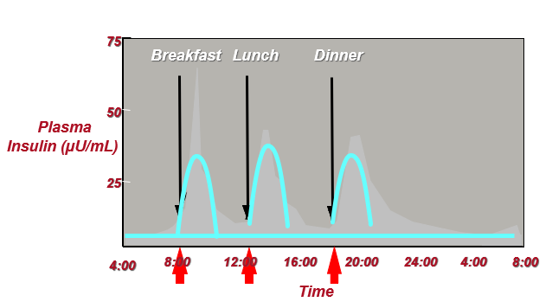
Preferred Basal/Bolus Insulin Pattern
Notes:
Here is an illustration of insulin release in an individual without diabetes, in the background, and an approximation of insulin delivery in an individual with diabetes receiving multiple daily injections (MDI). This treatment regimen allows delivery of greater amounts of insulin when needed to address the glucose raising effects of mealtime or to correct elevate levels while providing the background insulin needs of the body at rest.
Insulin pump therapy allows for more precise insulin dosing at meals / corrections and the ability to better accommodate variations in background insulin needs affected by factors such as physical activity and stress.

Slide 9
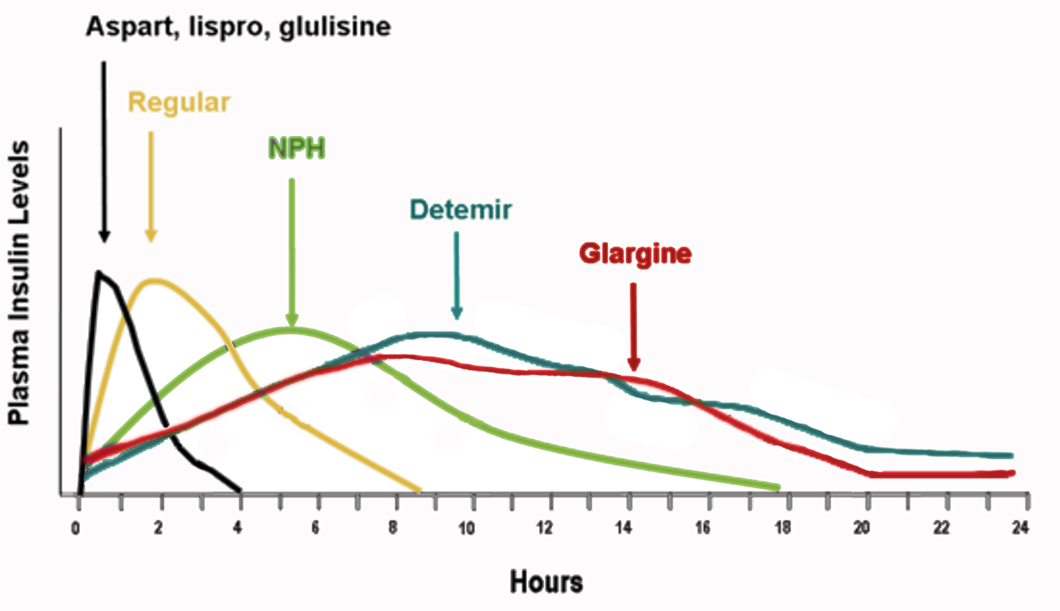
Insulin Types
BOLUS INSULIN
  Short-acting - Regular
  Rapid-acting - Lispro (Humalog®/Admelog®), Aspart (Novolog®), Glulisine (Apidra®, Lyumjev)
    Ultra rapid acting Aspart (Fiasp®)
    Ultra rapid acting Lispro (Lyumjev®)
BASAL INSULIN
  Intermediate - NPH
  Long-acting - Glargine (Lantus®/Basaglar®/Semglee®, Toujeo®), Detemir (Levemir®), Degludec (Tresiba®)
Notes:
The graph on this slide represents the action patterns of insulin types in use today.
Intermediate- and long-acting insulins provide basal insulin concentrations and doses are adjusted based on the student’s pattern of blood glucose. They are not used for acute treatment of high blood glucose levels and are not generally given at school or before meals. Intermediate and long-acting insulins are referred to as basal insulins. Basal insulins control the blood glucose in the fasting state, when you’re not eating. Basal insulin is typically 50% or less of an individual’s total daily insulin dose.
Rapid-acting insulins act quickly within 10-15 minutes and are used primarily to treat a high blood sugar level and to “match” or “cover” the rise in blood glucose levels that follow food intake. Many students require rapid acting insulin before meals and snacks. Note, hypoglycemia (low blood sugar) can occur if a meal or snack is delayed greater than 15 minutes after injection of rapid-acting insulin. Rapid-acting insulin is frequently referred to as bolus insulin. Rapid-acting insulin is also used in insulin pumps.
Short-acting insulins are used like rapid-acting insulins, but have a longer onset and duration of action and a delayed peak. Short-acting insulin is also referred to as bolus insulin.

Slide 10
Storing Insulin
Review the product storage instructions and check the expiration date
Generally, store opened insulin at room temperature, less than 86 degrees
Refrigerate unopened insulin vials and insulin pens
Be careful NOT to freeze
Notes:
The shelf life of insulin after opening varies according to:
the type of insulin,
the type of container (vial or cartridge), and
how insulin is used (in a pen, a cartridge, or a pump).
Review the product storage instructions on the manufacturer’s package insert and check the expiration date on the package for specific information.
In general,
Most opened vials of insulin may be left at room temperature (below 86 degrees Fahrenheit) for 30 days.
Most opened disposable pens or pen cartridges may be left at room temperature for less than 30 days, depending on the type of insulin and the type of pen or cartridge.
Unopened vials should be stored in a refrigerator and are good until their expiration date.

Slide 11
When to Give Insulin
DMMP SHOULD SPECIFY DOSING CLEARLY
Generally:
Before meals or snacks
For blood glucose levels above target range
For moderate or large ketones, call provider for dose
Notes:
Insulin must be administered as specified in the student’s DMMP. The DMMP specifies the orders of the student’s health care provider.
The DMMP should clearly specify insulin dosing procedures.
Generally, students will only need to administer their rapid-acting, bolus insulin at school. Their basal insulin will be delivered at home in the morning and/or evening, or throughout the day by insulin pump.
Generally, bolus insulin, either rapid or short acting insulin, will be given:
Before meals or some snacks, depending on DMMP recommendations
For blood glucose levels significantly above target range
For moderate or large ketones

Slide 12
Insulin Injections
Inject into fatty layer under skin
Rotate sites
Student should choose site unless there is lipohypertrophy (fat accumulation) or scarring.
Common insulin injection sites:
abdomen, thighs, buttocks, upper arms
Notes:
Insulin works best when it is injected into a layer of fat under the skin, above the muscle tissue.
Rotating sites is important to insulin absorption.
Common preferred sites are the abdomen, thighs, buttocks, and upper arms.
Student should help choose injection site but should be guided away from “lumpy,” scarred, or bruised areas.

Slide 13
Dosing Insulin at School
Generally, students will only take rapid or short acting insulin at meals or snack times:
Some students will use a fixed insulin dose
Others will have a varied dose, depending upon:
  What food is eaten (carb dose) and/or
  Whether blood glucose is within the target range (correction dose)
Notes:
Many students will take rapid or short acting insulin at meal or snack times:
Some students will take the same dose, regardless of blood glucose level or food intake.
Doses for many students, though, will vary. For those whose doses vary, it is important to understand the 2 concepts of:
Carb or meal boluses, to cover what is eaten and
Correction boluses, to cover high blood glucose.
These two concepts are covered in the next two slides.

Slide 14
Carb Bolus to Cover Meals/Snacks
The insulin to carbohydrate ratio (CHO) varies student to student and may vary meal to meal/snack, as specified in their DMMP:
RECORDED:
EXAMPLE:
CALCULATE:
as 1 unit insulin per X grams of carbohydrate
1:10 ratio; 1 unit of insulin for every 10 grams of carbohydrate eaten
Meal of 60 grams CHO
60/10 = 6 units insulin
6 units of insulin are needed to cover this meal
Notes:
Most students who vary their dosing at mealtime, will do so using an insulin to carbohydrate ratio. The insulin to carb ratio:
Varies from student to student, may vary from meal to meal, and is specified in the DMMP
Specifies how much carbohydrate that each one unit of insulin (rapid or short-acting insulin) will cover or match
Calculating the Insulin to Carbohydrate Ratio:
For example, a common ratio is 1:10
Usually stated as 1 unit per x number of grams of carbohydrate
Calculate for a meal that contains 60 grams of carbohydrate. If the ratio is 1:10, then we take the 60 grams divided by 10 to get 6 units of insulin for the correct dose.

Slide 15
Correction Bolus to Lower Blood Glucose
Amount of insulin to lower blood glucose to target, usually calculated by sliding scale or
correction factor:
SLIDING SCALE:
Give units of insulin for each interval of blood glucose mg/dL
CORRECTION FACTOR:
(Blood glucose level – target blood glucose)/ correction factor = units of insulin to be given)
Example: 1 unit if 150–200 mg/dl, 2 units if 201–250 mg/dL, 3 units if 250+ mg/dL
Example: BG=150 mg/dL (actual) minus target BG (100 mg/dL) = 50 divided by correction factor (50 mg/dL) = 1 unit insulin needed as a correction bolus
Notes:
Correction Bolus: The amount of insulin to correct a blood glucose level above the student’s target range. Once again, this will vary from student to student. It may be stated as a stepwise correction dose / “sliding scale” or may need to be calculated using a formula to determine the dose.
The DMMP will specify if, when and how correction boluses are to be determined and given.
Sliding Scale: Correction doses are specified at specific blood glucose intervals: for example, a student may need 2 units for blood glucose from 150- 200, 3 units for 201-250, 4 units for 250+
Correction Factor: Correction doses are calculated by subtracting the target blood glucose from the actual (high) blood glucose. Then the difference is divided by a correction factor to determine how many units of insulin are needed to lower blood glucose to the target range.
For example, consider a student whose blood glucose level is 150 and the target is 100. If the correction factor is 50, this means 1 unit of insulin would be given as a correction dose to correct for high blood glucose.

Slide 16
Insulin Bolus for Both
Carbs and Correction
For some students, dosing at mealtime may include both a carbohydrate dose and a correction dose
Total dose =
carb dose + correction dose
If student’s blood glucose is below target range, the correction may mean giving less than the usual dose. Follow DMMP for each student.
Notes:
For some students dosing at mealtime may include both a and carbohydrate dose and a correction dose for blood glucose that is above or below the target range.
In this case, Total dose = Carb dose + Correction dose.
If the student’s blood glucose is below target range, the correction may mean giving less than the usual dose.
Students whose dosing accounts for both carbohydrates and blood glucose are more likely to need assistance from school staff. Many insulin pumps will automatically calculate the correction dose when blood glucose levels and carbohydrate intake are entered into the pump.

Slide 17
Routine After Giving Insulin
Check site for leakage
Document on log sheet
Recheck glucose after insulin administration per DMMP.
Correction doses:
Recheck per DMMP to check effectiveness
Meal/snack doses:
Timeliness in relation to eating
Supervision of food amount per DMMP
Notes:
A few points to keep in mind after insulin is given, regardless of whether it is by syringe, pen, or pump.
Occasionally injection sites or infusion sites will leak when insulin is administered.
Document on log sheet.
When correction doses are given to lower blood glucose, a retest should be done, if specified in the DMMP, to determine how well the correction dose worked.
Ideally, mealtime insulin should be given prior to eating the meal or snack. When insulin has been given prior to eating, it is important that the food is eaten soon (beginning within 15 minutes) after the insulin has been taken. If necessary, the student should be moved to the front of a long line, or given milk, juice or some other quick-acting carbohydrate (this should be included in their carbohydrate coverage dose if the student is not hypoglycemic). Younger students may need to be supervised at every meal/snack to be sure the amount of food eaten is appropriate for the insulin given.

Slide 18
Module 7 Pre- and Post-Tests:
INSULIN BASICS
This tool may be freely duplicated and distributed for training purposes

Slide 19
Insulin is __________ that moves glucose from the blood into the cells for energy.
  A steroid
  A hormone
  A pain killer
  An oral medication
Bolus insulin is given to cover meals/snacks and:
  Increased physical activity
  To make the student more alert
  To correct hyperglycemia
  None of the above
Insulin is administered through a:
  Mouth
  Syringe
  Pump or pod
  Meter
  Pen
  b, c, e
  None of the above
Basal insulin is a slow steady stream of insulin.
  True
  False

Slide 20
Disclaimer
This presentation is not intended to provide legal or health care advice. Please consult with a legal or health care professional regarding your specific questions or needs.
Notes:
These components are:
• Diabetes Basics
• Diabetes Medical Management Plan
• Hypoglycemia
• Hyperglycemia
• Blood Glucose Monitoring
• Continuous Glucose Monitoring
• Glucagon Administration
• Insulin Basics
• Insulin by Syringe and Vial
• Insulin by Pen
• Insulin by Pump
• Ketones
• Nutrition and Physical Activity
• After-School Programs, Sports and Camps
• Before- and After- School Care
• Childcare
• Psychosocial Aspects
• Legal Considerations
• Type 2 Diabetes

Slide 21
Where to Get More Information
AMERICAN DIABETES ASSOCIATION
1-800-DIABETES (342-2383)
DIABETES.ORG/SAFEATSCHOOL

