Slide 1
GLUCAGON ADMINISTRATION
Diabetes Care Tasks at School
What Key Personnel Need To Know
Notes:
The American Diabetes Association’s (“ADA”) Diabetes Care Tasks at School: What Key Personnel Need to Know is a training curriculum consisting of PowerPoint modules, some with corresponding video segments, pre-/post-tests and other helpful resources.
This curriculum is based on and should be used in conjunction with the ADA’s Safe at School Guide “Helping the Student with Diabetes Succeed: A Guide for School Personnel”. Training participants should read the ADA Safe at School Guide in conjunction with this training to gain a better understanding of the requirements for appropriate school diabetes care. The ADA’s Safe at School Guide can be found www.diabetes.org/sastraining.
Some key points about the overall training:
Overall objective: The overall goal is to optimize safety, health, learning, and access for students with diabetes by providing diabetes education and training to school personnel to perform routine and emergency diabetes care tasks for students, under the supervision of a school nurse or another qualified health care professional. Completion of this training will help prepare school personnel to perform diabetes care tasks, ensuring that health needs are addressed in times and locations when a nurse is not available to provide needed care.
Rationale: The school nurse, when available, is the most appropriate person in the school setting to provide care for a student with diabetes. However, many schools do not have full-time nurses. Even for schools that do, the nurse may not always be available during the school day, during school-sponsored extra-curricular activities or field trips to assist with routine care and emergency care. Trained school personnel must be available to perform and assist the student with diabetes care tasks.
PLEASE STATE: This presentation is not intended to provide legal or health care advice. Please consult with a legal or health care professional regarding your specific questions or needs.

Slide 2
Optimal Student Health and Learning
GOAL:
Timely glucagon administration, when indicated, is a vital piece of the Diabetes Medical Management Plan (DMMP).
Notes:
Each training component was created specifically for school nurses and other qualified health care professionals to train school personnel.
These components are:
• Diabetes Basics
• Diabetes Medical Management Plan
• Hypoglycemia
• Hyperglycemia
• Blood Glucose Monitoring
• Continuous Glucose Monitoring
• Glucagon Administration
• Insulin Basics
• Insulin by Syringe and Vial
• Insulin by Pen
• Insulin by Pump
• Ketones
• Nutrition and Physical Activity
• After-School Programs, Sports and Camps
• Before- and After- School Care
• Childcare
• Psychosocial Aspects
• Legal Considerations
• Type 2 Diabetes
This unit is Glucagon.

Slide 3
Learning Objectives
PARTICIPANTS WILL BE
ABLE TO UNDERSTAND:
What glucagon is
How glucagon should be stored
When glucagon is used
How to administer glucagon
Notes:
Participants will be able to understand:
What glucagon is
How glucagon should be stored
When glucagon is used
Participants will be able to demonstrate:
How to administer glucagon

Slide 4
What is Glucagon?
Naturally occurring hormone made in the pancreas
Lifesaving, hormone that raises blood glucose (blood sugar) level by stimulating the liver to release stored glucose
Glucagon as injectable (ready-to-use or requires reconstitution)
Treatment for severe hypoglycemia
Lifesaving, cannot harm a student—cannot overdose
Glucagon as nasal powder
Notes:
Glucagon is a hormone that occurs naturally in the body. It is produced in the pancreas and raises blood glucose levels by causing the release of glycogen (a form of stored carbohydrate) from the liver that raises blood glucose levels.
Glucagon by injection is a life-saving prescription medication (called GlucaGen by one manufacturer). It is given by injection and used to treat serious hypoglycemia. It was created for use by people who are not health care professionals. Many students may use a glucagon kit that requires reconstitution. However, there are ready-to-use kits that are increasingly available for student use (called Gvoke by one manufacturer). Gvoke is an auto-injector and pre-filled syringe.
Glucagon by nasal powder is a life-saving prescription medication (called baqsimi by one manufacturer). It is given, needle-free, by providing in the nostril where it is passively absorbed and used to treat serious hypoglycemia. It was created for use by people who are not health care professionals.
If it is specified in the student’s Diabetes Medical Management Plan (DMMP), glucagon should be used when the student is unconscious, experiencing convulsions, or cannot eat or drink safely. Severe hypoglycemia can cause brain damage or death.
While it may cause nausea and vomiting when the student regains consciousness, glucagon is a life-saving treatment that cannot harm a student. Cannot overdose.

Slide 5
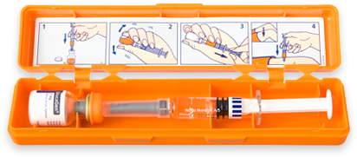
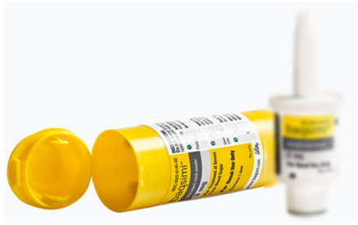
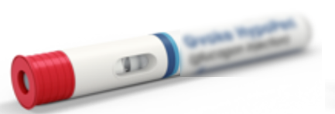
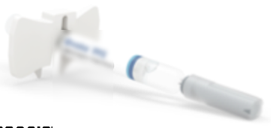
Glucagon Formulations
Injection
Nasal powder
Requires reconstitution
After mixing, dispose of any unused portion within one hour
Ready to use
Single dose, should not be reused
HypoPen or prefilled syringe
Ready-to-use
Single dose, cannot be reused
Notes:
When included in the DMMP or physician’s orders, the glucagon kit should be accessible to trained school personnel, and stored in a designated place which may include keeping the kit with the student. Many students will have a kit that requires reconstitution but other formulations now exist and are used when able.
Newer formulations include:
Gyvoke is a ready-to-use glucagon that is approved for 2 years of age and older. It’s available in a Hypopen or prefilled syringe.
Baqsimi is a ready-to-use nasal powder form of glucagon that is approved for 4 years of age and older.
The student’s diabetes provider will determine glucagon based on the student’s individual needs. Details for glucagon use should be outlined in the students DMMP.
Ready-to-use and nasal powder are a single dose and should not or cannot be reused. Any unused portion of glucagon that requires reconstitution should be disposed with one hour.

Slide 6
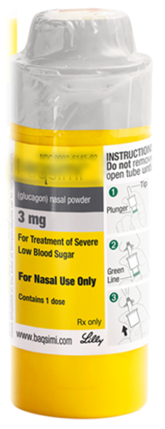
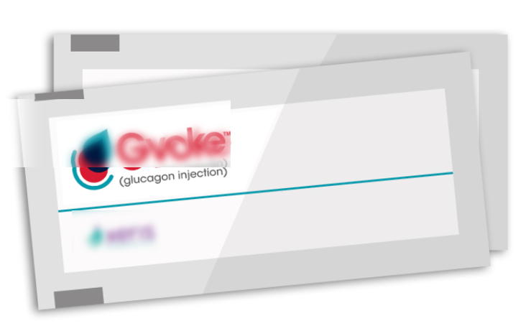
Storage
Maintain accessible to school personnel, as designated in DMMP
Packaging will depend on formulation
  Store at room temperature
  Monitor the expiration date
Nasal powder—ready-to-use
Injection—ready-to-use
Injection—requires reconstitution
Notes:
When included in the DMMP or physician’s orders, the glucagon kit should be accessible to trained school personnel, and stored in a designated place which may include keeping the kit with the student.
Glucagon should be stored at room temperature.
The expiration date should be checked before using. Do not administer if expired, discolored, or if requiring reconstitution, does not dissolve well.
Expired glucagon emergency kits can be used for future training sessions. Training demonstration kits are also available from kit manufacturers.

Slide 7
When to Give Glucagon/Glucagen
If authorized by the student’s DMMP and if student exhibits:
UNCONSCIOUSNESS, UNRESPONSIVENESS
CONVULSIONS (SEIZURES)
INABILITY TO SAFELY
EAT OR DRINK
Notes:
When hypoglycemia is severe, the school nurse or trained diabetes personnel must respond immediately.
Regardless of whether glucagon is to be given or not, emergency personnel should be summoned by calling 911 or emergency response personnel as soon any of the following are exhibited:
Unconsciousness, unresponsive
Convulsions (seizures) or jerking movements
Inability to safely eat or drink
If student is having a seizure, is unconscious, or having difficulty swallowing, do not attempt to give food or a drink or to put anything in his or her mouth because it could cause the student to choke.

Slide 8
Procedure
Act immediately
If possible, check blood glucose, don’t delay
If in doubt, always treat
Position student safely on side for comfort and protection from injury
School nurse or trained personnel notified to give glucagon in accordance with DMMP or emergency care plan
Call 911, parent/guardian, school nurse as per DMMP or emergency care plan
Notes:
If possible, do a blood glucose check.
Don’t delay if a meter is not available and low blood glucose symptoms are being exhibited. If in doubt, always treat.
Position student safely – Be sure that the student is lying on his or her side in a clear, safe area protected from head and bodily injury.
Do not leave student alone.
School nurse or other trained diabetes personnel should give glucagon as soon as possible after discovering that the student is unconscious or unable to swallow.
A second person should call 911, then parent/guardian and school nurse as per DMMP.

Slide 9
Emergency Kit Contents
*Subcutaneous or intramuscular use
1 mg of freeze-dried glucagon (vial)
1 ml of water for reconstitution (syringe)
COMBINE IMMEDIATELY BEFORE USE
Notes:
Details for 3-methods of delivery will be discussed but in addition to participating in this training, instructions inside the student’s kit should be reviewed. This photo shows the inside of a glucagon emergency kit. This glucagon requires reconstitution (mixing) and must be injected.
Instructions are included in package.
Within this glucagon kit are:
a syringe pre-filled with a saline and
a vial of powdered glucagon.
Combine the glucagon for injection immediately before use by following the instructions that are included with the glucagon kit.

Slide 10
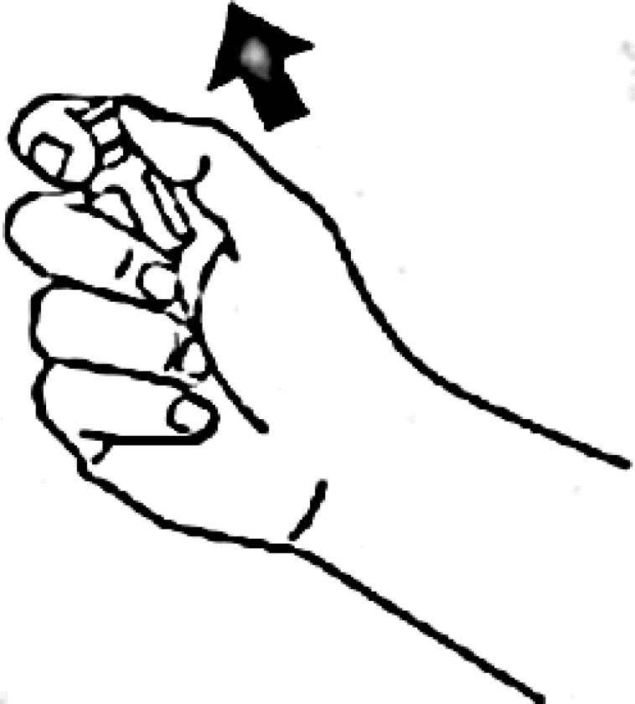
Preparation
1. Flip cap off glass vial containing dry powder
2. Remove cap from syringe
3. Put on gloves if available
Notes:
1. Flip the plastic cap off the glass vial of powdered glucagon.
2. Remove the plastic cap off the syringe needle. Do not remove plastic clip from syringe as it prevents the rubber stopper from being pulled out.
3. Put on gloves if available

Slide 11
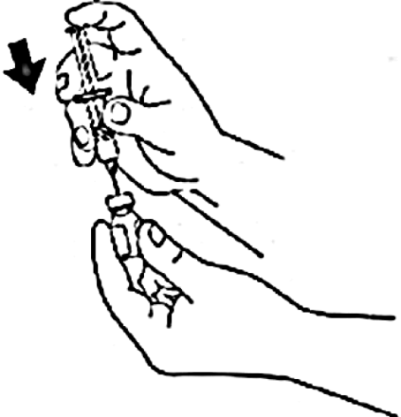
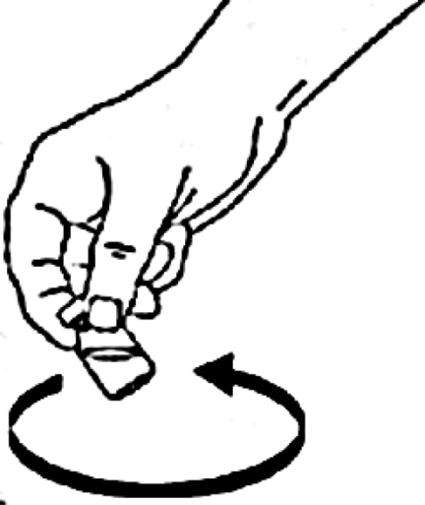
Mixing Solution
Inject entire fluid in syringe into the bottle containing powder
Shake gently or roll to mix until all powder is dissolved and solution is clear.
Notes:
4. Take the fluid filled syringe in the glucagon emergency kit and inject the fluid into the bottle containing the glucagon powder.
5. Shake gently or roll to mix until all powder is dissolved and solution is clear.

Slide 12
Dosing and Drawing Out
Inspect. Solution should be clear and colorless.
Draw back prescribed amount of glucagon back into syringe as stated in the DMMP, since many students may not receive the full dose.
Notes:
6. Inspect medication for color, clarity, and presence of lumps. Solution should be clear and colorless.
7. Draw a prescribed amount of glucagon back into syringe. Amount is per DMMP. General guidelines are as follows:
If child weighs > 45 lbs., inject the full vial of glucagon (1 cc) using the buttocks, thigh, or arm.
If child weights < 45 lbs., inject 1/2 of the solution.
Do not recap syringe. Discard sharp in appropriate container.

Slide 13
Injecting
Clean site if possible.
Inject at 90° into the tissue under cleansed area (may administer through clothing as necessary)
  buttocks
  thigh
  arm
Notes:
8. When possible, the injection site should be exposed and cleaned. However, glucagon can be administered without cleaning and through clothing if necessary.
9. Injection is given at a 90 degree angle into the tissue under the cleansed area in an area such as the buttocks, thigh or arm. Suggested sites include the outer thigh, upper outer buttock, or arm.

Slide 14
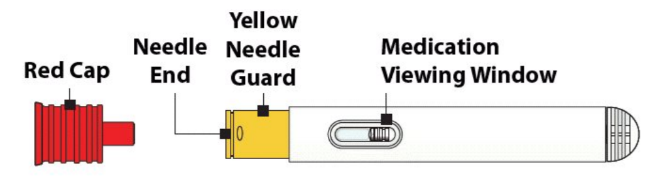
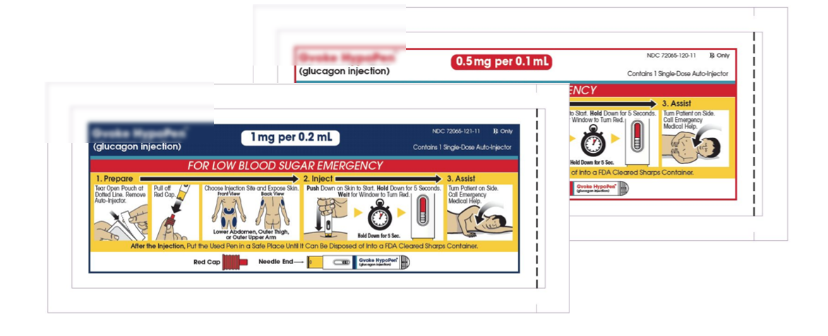
Auto-injector package contents:
*Subcutaneous use only for auto-injector and pre-filled syringe
Notes:
This photo shows the inside of a glucagon foil pouch containing the Gyvoke HypoPen™ made by one manufacturer. The pre-filled syringe is also found in a foil pouch but will not be reviewed in these slides. Instructions for glucagon are always included on the package. The auto-injector or pre-filled syringe glucagon must be injected and are intended for subcutaneous tissue (fat tissue) only.
Open the package immediately before use by following the instructions that are included with the glucagon foil pouch.

Slide 15
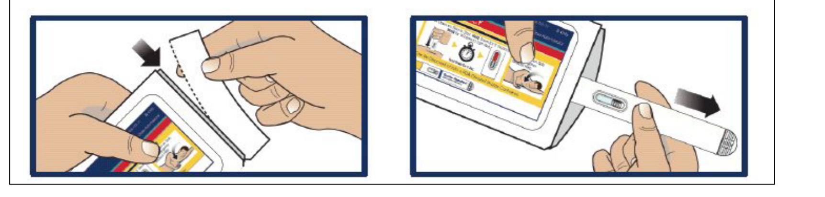
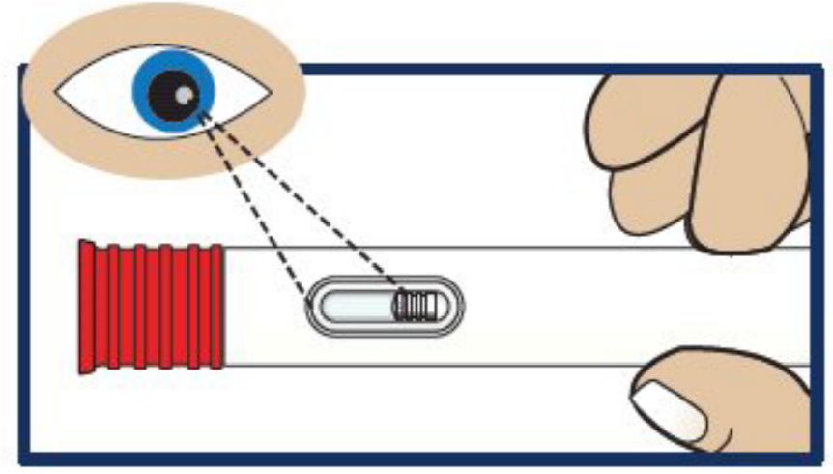
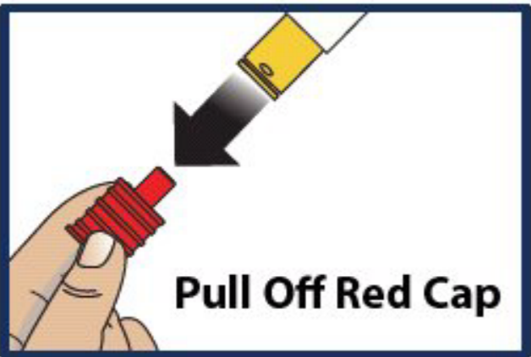
Preparation with Auto-Injector
Tear open pouch at dotted line and carefully remove pen
Inspect. Solution should be clear and colorless (or pale yellow)
Pull the red needle cap straight off
Choose site and expose bare skin—do NOT administer ready-to-use through clothing and inject into fatty tissue only:
  Lower abdomen, outer thigh, outer arms
Notes:
1. Tear open pouch at dotted line and carefully remove pen
2. Inspect. Solution should be clear and colorless (or pale yellow)
3. Pull the red needle cap straight off
4. Choose site and expose bare skin – do NOT administer ready-to-use through clothing and inject into fat tissue only: lower abdomen, outer thigh, outer arms

Slide 16
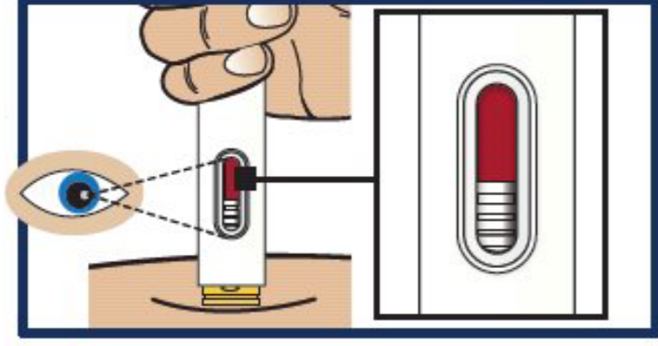
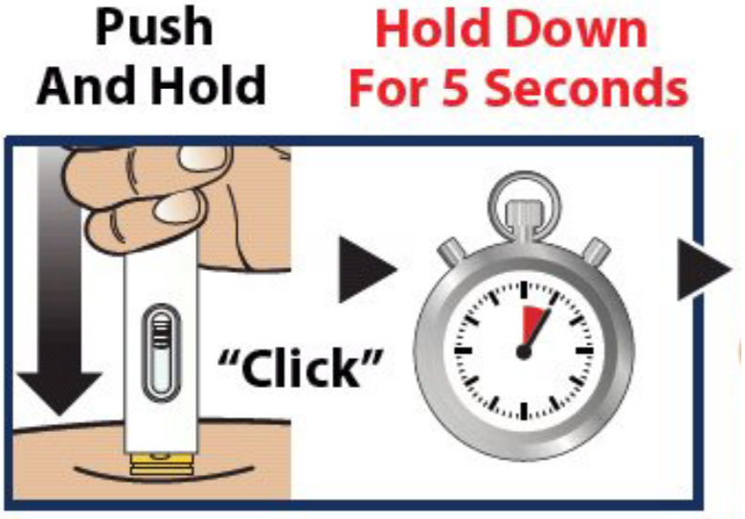
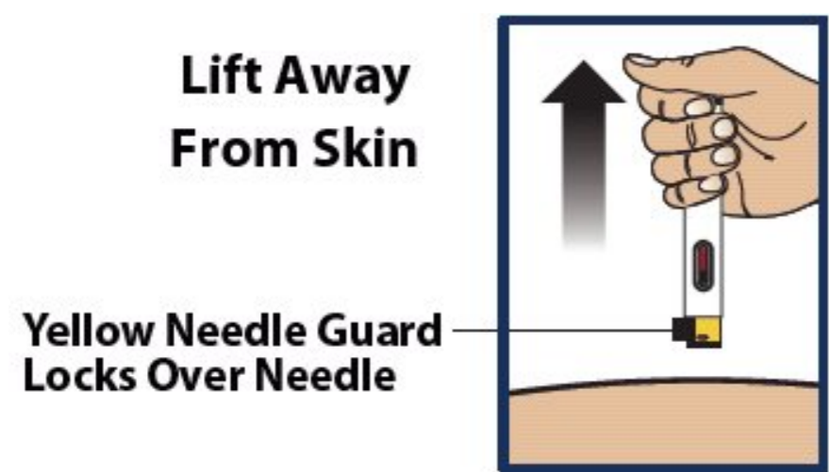
Injection with Auto-Injector
Use gloves and clean site, if possible. Push and hold straight down against the injection site. Listen for a click.
Continue to hold the device down and count slowly to 5.
Lift the device straight up—the yellow needle guard will lock over the needle. Carefully replace the red cap.
Notes:
5. Use gloves and clean site, if possible. Push and hold straight down against the injection site. Listen for a click.
6. Continue to hold the device down and count slowly to 5.
7. Lift the device straight up – the yellow needle guard will lock over the needle. Carefully replace the red cap.

Slide 17
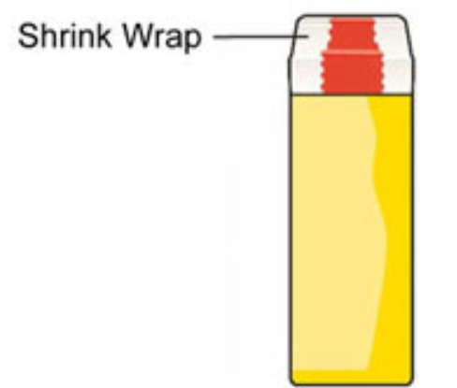
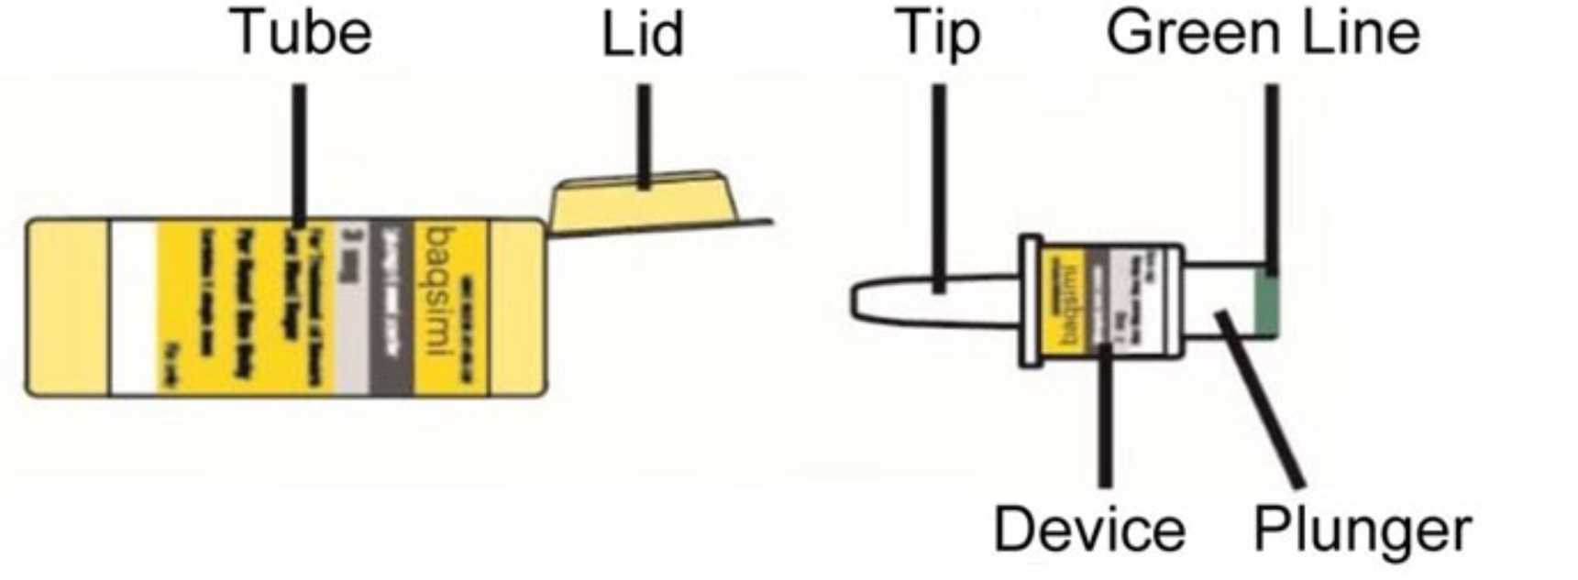
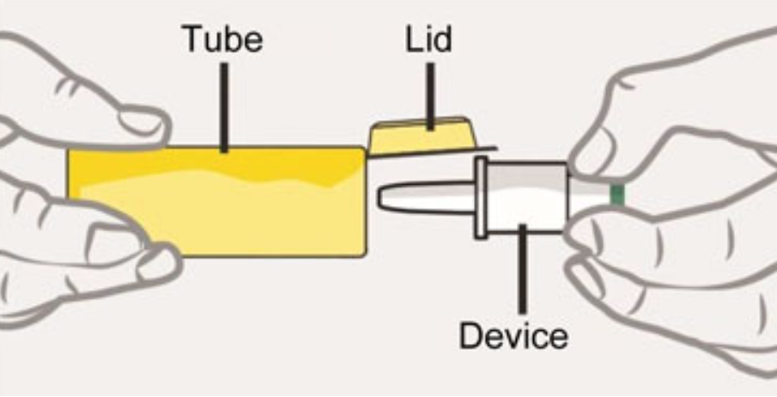
Nasal Powder Glucagon
KIT CONTENTS
PREPARATION
Remove the shrink wrap by pulling on the red stripe
Open the lid and remove – be careful not to press the plunger until ready to give
Notes:
This photo shows nasal glucagon (baqsimi® is available by one manufacturer). This nasal powder is currently only available in 1-dose (3mg) and approved for those 4 years and older. Instructions for glucagon are always included on the package. The contents are passively absorbed in the nasal mucosa. The dose does not need to be inhaled.
Open the package immediately before use by following the instructions that are included with the glucagon tube.

Slide 18
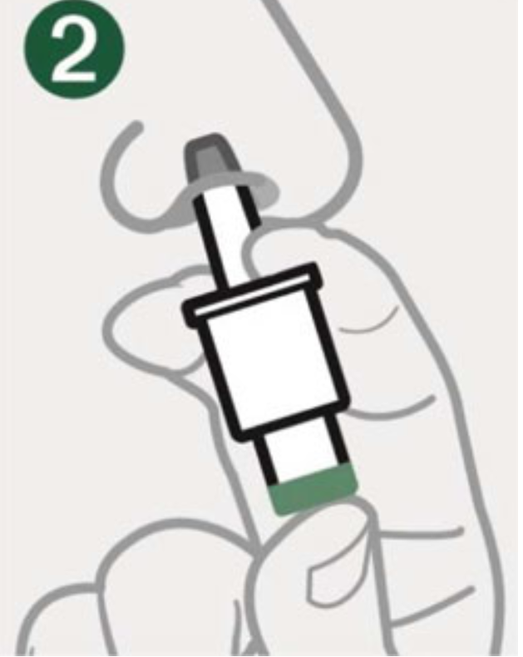
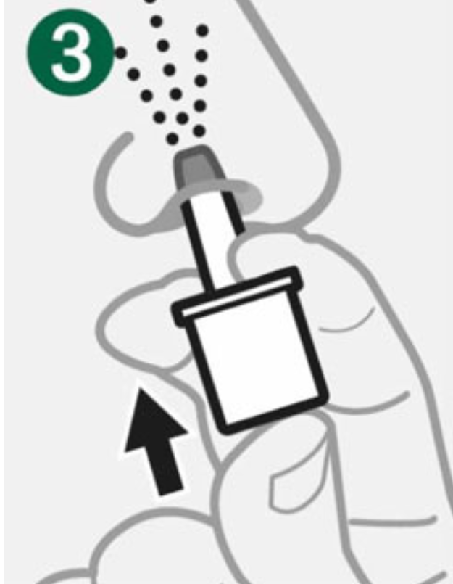
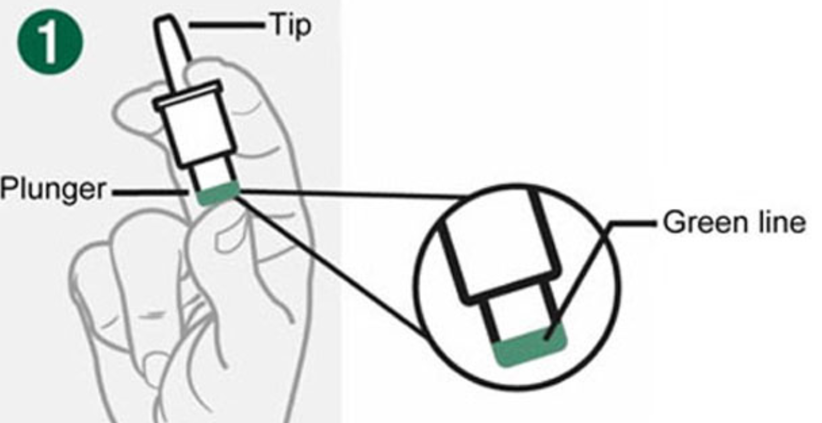
Nasal Powder Glucagon
1
2
3
Use gloves if possible. Hold device between fingers and thumb—do not push plunger yet.
Insert tip gently into one nostril until finger(s) touch the outside of the nose.
Push plunger firmly al the way in. Dose is complete when the green line disappears.
Notes:
1. Use gloves if possible. Hold device between fingers and thumb – do not push plunger yet.
2. Insert tip gently into one nostril until finger(s) touch the outside of the nose
3. Push plunger firmly al the way in. Dose is complete when the green line disappears.

Slide 19
After Injection or Nasal Dose
May take 10–20 minutes for student to regain consciousness
Check blood glucose
Give sips of fruit juice or regular soda, once student is awake and able to drink
Advance diet as tolerated
Document as per DMMP
If injection, do not recap syringe. Discard sharp in appropriate container
Notes:
After providing glucagon (injection or nasal powder), it’s very important to monitor and provide additional management, per DMMP.
It may take 10-20 minutes for student to regain consciousness.
Check blood sugar 15-20 minutes after administering glucagon.
Give sips of regular soda or fruit juice once student is awake and able to drink. 13. Follow with concentrated sugar with snack containing proteins and carbohydrates such as peanut butter sandwich or cheese crackers to keep blood glucose levels elevated to normal levels and to prevent recurrence.
Document blood glucose level and glucagon dosage as per DMMP.
If injection, do not recap syringe. Discard sharp in appropriate container.

Slide 20
Considerations
The time to complete recovery from a severe hypoglycemic (low blood glucose) episode varies according to how low the blood glucose level was and for how long prior to treatment
Some signs and symptoms, such as headache, may persist for several hours, although the blood glucose level is satisfactory
Continued monitoring is important
Student may need to be transported via EMS or go home with parent/guardian
Notes:
The time to complete recovery from a severe hypoglycemic episode varies according to how low the blood glucose level was and for how long prior to treatment.
Some signs and symptoms, such as headache, may persist for several hours, although the blood glucose level is satisfactory. The student may be unable to participate in learning or school activities up to several hours after a severe hypoglycemia episode.
Continued monitoring is important, but is a challenge in the school setting. The student may need to be transported via EMS or sent home with the parent/guardian.

Slide 21
Don’t Be Surprised If…
Student does not remember being unconscious, incoherent, or has a headache
Blood glucose becomes high (over 200 mg/dl)
Nausea or vomiting may occur
Notes:
Don’t be surprised if …..
Student does not remember being unconscious, incoherent or has a headache.
Blood glucose becomes very high (over 200)
Nausea or vomiting may occur

Slide 22
Module 10 Pre- and Post-Tests:
GLUCAGON ADMINISTRATION
This tool may be freely duplicated and distributed for training purposes

Slide 23
Glucagon is used to treat:
  Hyperglycemia
  Hypoglycemia
Glucagon is a naturally occurring hormone made by the pancreas.
  True
  False
Glucagon is given when:
  Unconsciousness/unresponsiveness
  Convulsion/seizure
  Inability to safety eat or drink
  All the above
Glucagon is administered through a:
  Mouth
  Injection
  Nasal powder
  Pen or auto-injector
  b, c, d
  All the above
The student should be positioned on his or her side before glucagon is administered:
  True
  False

Slide 24
Disclaimer
This presentation is not intended to provide legal or health care advice. Please consult with a legal or health care professional regarding your specific questions or needs.
Notes:
These components are:
• Diabetes Basics
• Diabetes Medical Management Plan
• Hypoglycemia
• Hyperglycemia
• Blood Glucose Monitoring
• Continuous Glucose Monitoring
• Glucagon Administration
• Insulin Basics
• Insulin by Syringe and Vial
• Insulin by Pen
• Insulin by Pump
• Ketones
• Nutrition and Physical Activity
• After-School Programs, Sports and Camps
• Before- and After- School Care
• Childcare
• Psychosocial Aspects
• Legal Considerations
• Type 2 Diabetes

Slide 25
Where to Get More Information
AMERICAN DIABETES ASSOCIATION
1-800-DIABETES (342-2383)
DIABETES.ORG/SAFEATSCHOOL

